Slide 1

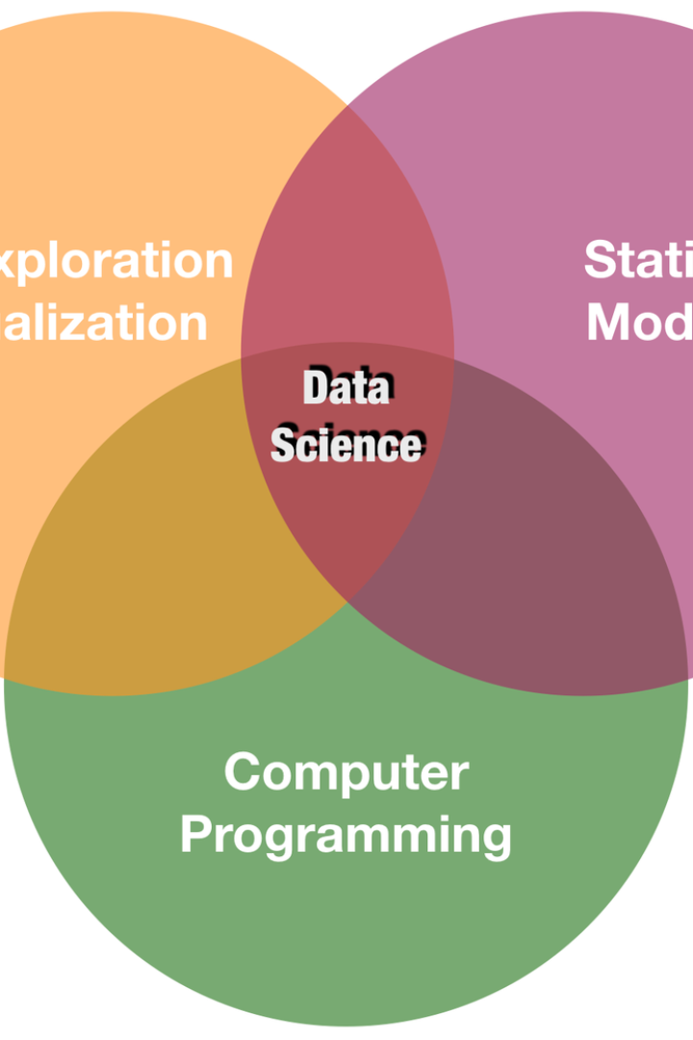
Introduction
The introduction section provides an overview of the upcoming detailed analysis of the catalog scoring mechanism. The objective is to evaluate the transparency, accuracy, and potential biases in the scoring process. This analysis will aid in identifying areas for improvement and enhancing the overall integrity of the catalog scoring mechanism.

Slide 2
Overview of the catalog scoring mechanism
Scoring Process
Key Metrics
Evaluation Criteria
The mechanism follows a structured process for evaluating and assigning scores to catalog entries based on predefined criteria. Each criterion is meticulously assessed to ensure a fair and balanced scoring system.
It incorporates various key metrics, including relevance, completeness, and accuracy, to ensure a comprehensive evaluation of catalog entries. The utilization of multiple metrics contributes to the robustness of the scoring mechanism.
It outlines clear evaluation criteria to maintain consistency and objectivity in the scoring process. Transparency in the criteria is crucial to instill confidence in the overall reliability of the scoring mechanism.

Slide 3
Importance of transparency in the scoring mechanism
1
Accountability
2
Stakeholder Understanding
3
Reputational Integrity
Transparency enhances accountability by allowing stakeholders to understand the scoring process and outcomes, thereby promoting trust and confidence.
Transparent scoring mechanisms facilitate a better understanding among stakeholders, leading to improved collaboration and informed decision-making.
Publicly transparent mechanisms contribute to the reputation and integrity of the organization, fostering positive relationships with stakeholders and the community.

Slide 4



Test case objectives and methodology
Objective Setting
Methodology Design
Validation Process
Establish clear and measurable objectives for the test case to ensure comprehensive examination of the scoring mechanism.
Develop a robust methodology including data collection, analysis, and comparison to evaluate the transparency of the catalog scoring process.
Execute a thorough validation process to ensure the reliability and accuracy of the test case outcomes.

Slide 5

Examination of data sources and algorithms used in the scoring mechanism
1
Data Sources
Evaluate the reliability and diversity of data sources used in the scoring mechanism to ensure comprehensive coverage and accuracy.
2
Algorithm Selection
Analyze the appropriateness and effectiveness of the algorithms utilized for scoring catalog entries to gauge fairness and transparency.
3
Integration Assessment
Assess the integration of data sources and algorithms to identify potential synergies and alignment with the scoring objectives.

Slide 6
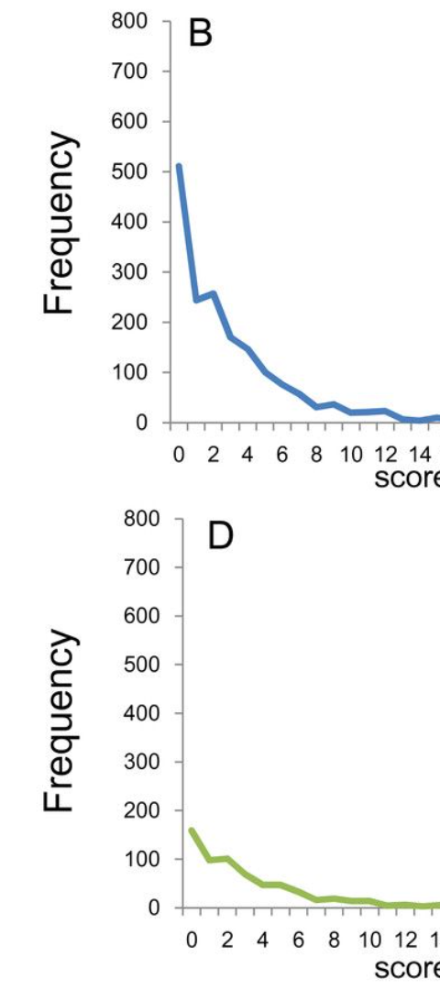
Analysis of scoring results and comparison with expected outcomes
Score Accuracy
Examine the accuracy of the assigned scores to catalog entries and compare them with the expected outcomes to identify any discrepancies.
Performance Analysis
Analyze the overall performance of the scoring mechanism against predefined benchmarks to determine its effectiveness and fairness.
Outcome Comparison
Compare the actual scoring outcomes with the anticipated results to ascertain the alignment with the set evaluation criteria.

Slide 7
Identification of any discrepancies or potential biases in the scoring mechanism
Discrepancies
Conduct a detailed examination of any disparities or inconsistencies in the scoring outcomes to identify potential loopholes in the mechanism.
Biases Assessment
Assess the presence of biases, if any, during the scoring process to ensure objectivity and fairness in the evaluation.
Transparency Review
Review the overall transparency of the mechanism to pinpoint any areas requiring enhancements to mitigate potential biases.

Slide 8


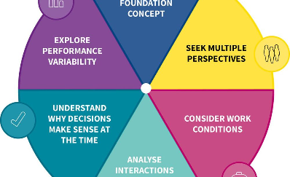
Recommendations for improving transparency and accuracy in the catalog scoring mechanism
Enhanced Transparency
Accuracy Enhancement
Systemic Improvement
Suggest strategies to enhance transparency in the scoring mechanism, including clear documentation and accessible communication channels.
Provide recommendations to enhance the accuracy of the scoring process through the refinement of evaluation criteria and algorithmic adjustments.
Propose systemic improvements to foster a culture of continuous enhancement and integrity in the catalog scoring mechanism.

